Slide 1

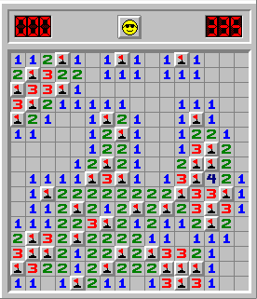
Rules | Play | Final Results
MINI PROJECT:
MINESWEEPER

Slide 2
TEAM MEMBERS
SNEHAL GUPTA-MABSPG24069
ARYAN CHAUHAN -MABSPG24087
UTKARSH RAJ-MABSPG24100
VINAY SEJWAL-MABSPG24113
VRINDA GOEL-MABSPG24120

Slide 3


Rules | Play | Final Results
INTRODUCTION
Minesweeper is a classic logic-based puzzle game where the player must uncover a grid without clicking on hidden mines. This implementation uses Python's Pygame library to create an interactive 2D graphical version of the game. The goal is to click and reveal all non-mine cells without triggering a mine

Slide 4


Rules | Play | Final Results
OBJECTIVE
TO CREATE AN INTERACTIVE GRID-BASED GAME THAT:
RANDOMLY PLACES MINES ON THE GRID.
REVEALS ADJACENT CELL NUMBERS.
ENDS THE GAME WHEN A MINE IS CLICKED.

Slide 5

Rules | Play | Final Results
SETUP INSTRUCTIONS
INSTALL DEPENDENCIES:
PIP INSTALL PYGAME
RUN THE GAME:
PYTHON GAME\ 2.IPYNB

Slide 6
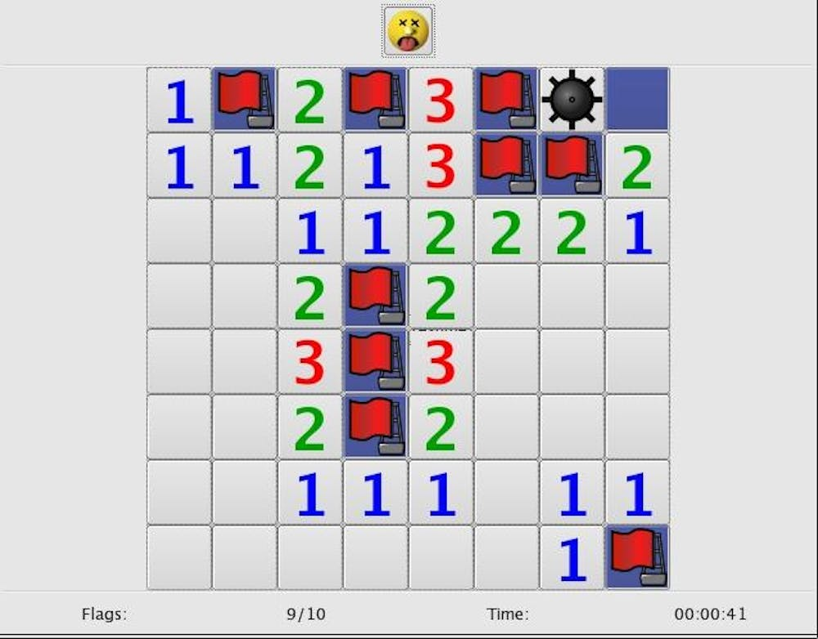
Rules | Play | Final Results
DEPENDENCIES
PYGAME – FOR GRAPHICS AND GAME LOOP.
RANDOM – FOR RANDOM MINE PLACEMENT.
SYS – TO HANDLE SYSTEM EXIT.

Slide 7
Rules | Play | Final Results
DATA TYPES USED
int – for coordinates, grid values, and counters.
list – to represent the grid and track revealed cells.
bool – for revealed cell status and game-over state.
tuple – for direction offsets and RGB colors.

Slide 8
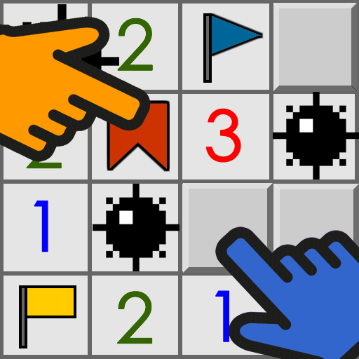
Rules | Play | Final Results
LOOP
WHILE LOOP – MAIN GAME LOOP.
FOR LOOPS – USED IN GRID INITIALIZATION, DRAWING, AND EVENT HANDLING.

Slide 9
Rules | Play | Final Results
FUNCTIONS
GET_CELL_COORDS() – COMPUTES PIXEL LOCATION OF A GRID CELL.
INIT_GAME() – SETS UP GAME GRID AND MINES.
PLACE_MINES() – RANDOMLY ASSIGNS MINES TO GRID.
CALCULATE_ADJACENT_MINES() – COUNTS SURROUNDING MINES PER CEL
REVEAL_CELL() – REVEALS A CELL AND RECURSIVELY EMPTIES ADJACENT CELLS IF NEEDED.
HANDLE_CLICK() – MANAGES USER INPUT AND IDENTIFIES CLICKED CELL.
DRAW_GRID() – RENDERS ALL GAME VISUALS ON SCREEN.
DRAW_GAME_OVER() – DISPLAYS "GAME OVER" MESSAGE.
MAIN() – INITIALIZES THE GAME AND CONTROLS THE GAME LOOP.

Slide 10
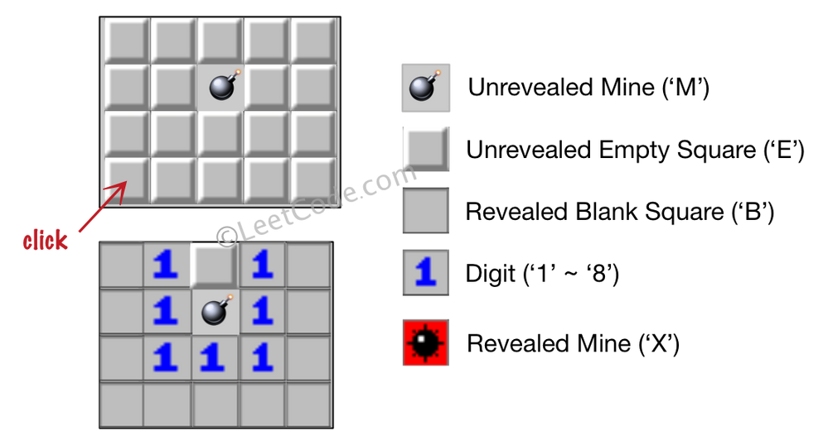
Rules | Round 3 | Final Results
CONDITIONALS
IF STATEMENTS USED THROUGHOUT:
CHECKING GAME OVER CONDITION.
CHECKING IF A CELL HAS ALREADY BEEN REVEALED.
VALIDATING MINE PLACEMENTS.
RENDERING VISUALS BASED ON GAME STATE.

Slide 11
Rules | Round 3 | Final Results
FINDINGS
Functional and visually interactive grid-based game.
Recursive reveal algorithm works effectively for empty cells.
Game logic correctly ends on mine click.

Slide 12
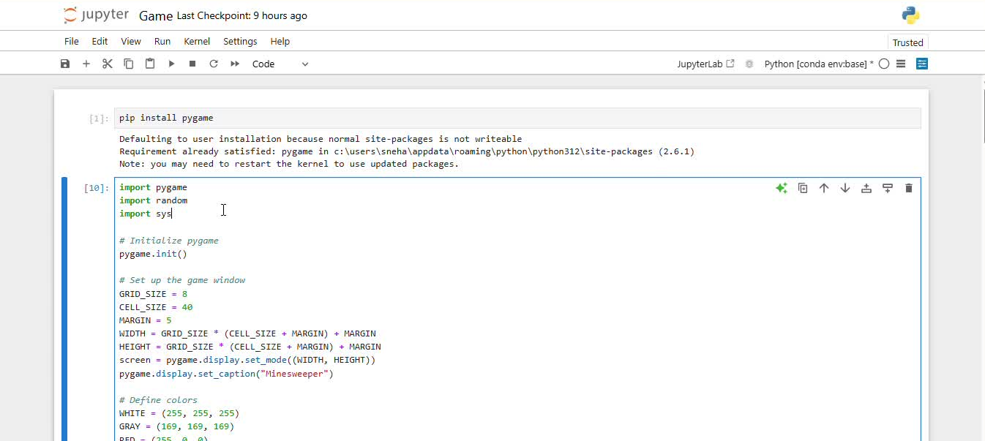
Rules | Play | Final Results
GAME - CODE
GAME - DEMO

Slide 13



Rules | Round 3 | Final Results
AND THE CONCLUSION IS...
This project demonstrates effective use of pygame for creating 2D games.
Covers core programming concepts like loops, conditionals, functions, and modularity.
It’s a solid foundation for expanding to a full-featured Minesweeper with flags, score tracking, and difficulty levels.

Slide 14


Rules | Round 3 | Final Results
THANK YOU FOR PLAYING!

